Slide 1
CSCI 543/DATA 532 - Machine Learning Fall 2025 Project Presentation Topic: Predicting future values for monthly electricity consumption
Vigneshwar (Vig) Parameshwar
Siddartha (Sid) Bandi

Slide 2
Presentation Plan
The following topics will be covered in our presentation:
Acknowledgement
Problem Statement and Motivation
Objectives
Project Significance
Literature Review
Data Used
Methodology / Models Used
Results and Analysis
Conclusion, Limitations and Future Work
References
2

Slide 3
Acknowledgement
While working on our project, we encountered some difficulty with obtaining the radar dataset.
Our sincere thanks to our Professor, Dr. Meera Gopinath Sujatha for her guidance to evaluate the performance of different regression models on electricity consumption data.
This project would not have been possible without the support of our teammate Taylor, who built the FFNN model. Her domain expertise helped us interpret the results.
Sid built the SVM and LSTM models and provided feedback on the report and slides
Vig was responsible for overall project management, code testing and providing feedback to Taylor/Sid, doing the literature review, drafting the report and making slides.
3

Slide 4
Problem Statement and Motivation
Goals: This goals of this project are three-fold:
To apply 3 supervised ML regression models to forecast monthly electricity consumption for two U.S. metro cities (Minneapolis and Phoenix)
Support Vector Machine (SVM)
Feed Forward Neural Network (FFNN)
Long Short-Term Memory (LSTM)
To determine which model(s) performed the best for this task
To use explainable AI techniques like SHAP and LIME to interpret the models and determine which features contributed to predicting the electricity consumption value
Motivation: This project idea came from Vig and Taylor’s PhD dissertations, which involve applying AI/ML techniques to space radar and meteorological data. We have used real electricity consumption data to build and test three ML models which Taylor needed to move her dissertation forward.
4

Slide 5


Objectives
With cities facing extreme weather and growth in population, accurately forecasting electricity demand is important for utilities, city planners and energy researchers
Understanding how temperature and seasonal patterns affect electricity consumption is critical
ML models execute quickly, identify patterns and learn data relationships
Audience: Can you guess the cities based on their skyline? ☺
Minneapolis, MN
Phoenix, AZ
5

Slide 6
Project Significance
Model Comparison: We evaluate three different supervised ML models to understand which approach is most effective for time-series energy forecasting.
Feature Engineering: We demonstrate how weather variables, seasonal encodings, and lagged features can improve electricity-use prediction.
Explainability: We use SHAP and LIME to interpret model behavior and highlight which features most strongly influence predictions.
Cross-Validation Use: We apply Time Series Split to measure how stable each model is and how well it generalizes when forecasting across different time periods.
6

Slide 7
Literature Review
SVM
Radhika et al [2] and Yin et al [3] show SVM to be effective for temperature and precipitation forecasting
LSTM, NN, Hybrid approaches
El-Azab et al. [6] worked on ISO New England region using ANFIS, LSTM, GRU, and ANN models.
xAI
Cui et al. [9] showed SHAP analysis provided interpretability, identifying common influential household characteristics and supporting the development of targeted, practical energy-efficiency strategies for the U.S. residential sector.
Hasan et al. [4] showed that SVR outperformed traditional forecasting methods for rainfall prediction using six years of historical data
Wang et al. [5] improved temperature prediction accuracy by optimizing SVM regression, raising the coefficient of determination from ~0.8 to ~0.9.
Dudek [9] investigated load forecasting across multiple countries with datasets exhibiting triple seasonality (annual, weekly, and daily cycles), integrating calendar effects and temperature. Random Forest was benchmarked against ARIMA, ETS, Prophet, MLP, SVM, ANFIS, LSTM and XGBoost.
Abumohsen et al. [7] analyzed hourly electrical load data from the Tubas Electricity Company in Palestine and compared LSTM, GRU, and RNN models.
LSTM and ANFIS consistently achieved the highest R² values across all seasons.
Gated Recurrent Unit (GRU) did best
RF outperformed
7

Slide 8
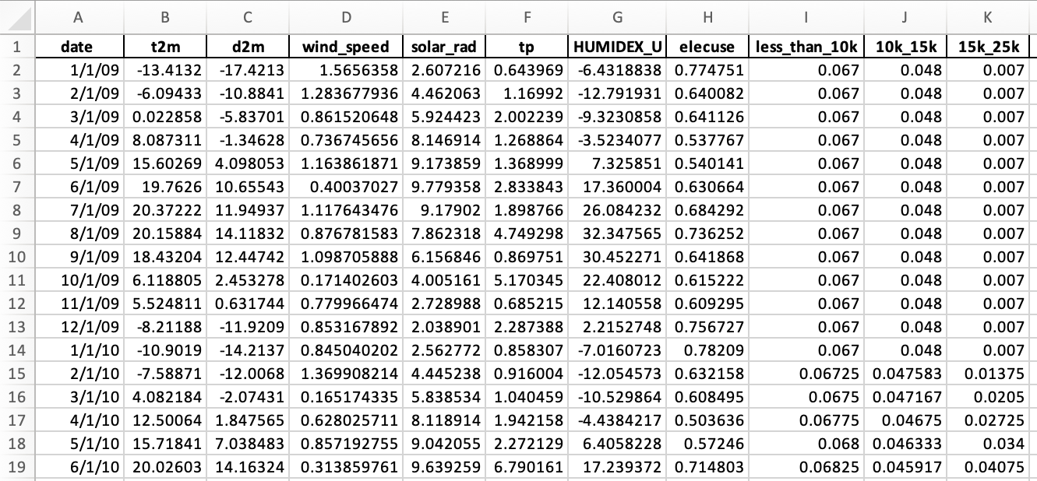
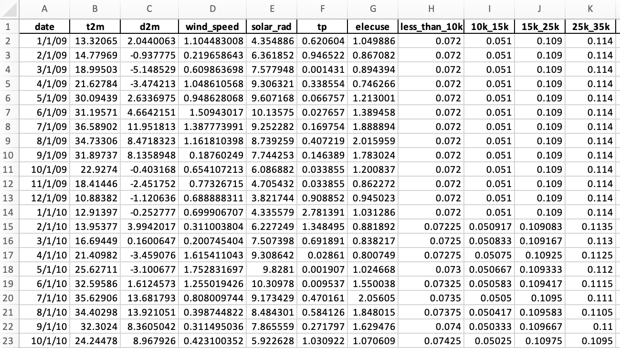
Data Used
Subset of Obringer dataset, collected from January 2007 thru December 2018
Provides monthly electricity usage for metro cities in the USA [1]
For this project, we focused on two U.S. cities: Minneapolis, MN and Phoenix, AZ
The Minneapolis data frame has 96 records (rows) with 53 features (columns)
The Phoenix data frame has 114 records (rows) with 47 features (columns), as the humidity index was not available
Image 1: Screenshot of Minneapolis Dataset
Image 2: Screenshot of Phoenix Dataset
8

Slide 9
Methodology / Models Used
Preparing the dataset for modeling (visualization, handling missing values, feature engineering, box plots for outliers, correlation heatmap)
Feature engineering performed by incorporating weather variables, seasonal encodings, and lagged features can improve electricity-use prediction.
Regression models used for electricity demand forecasting: SVM, FFNN, LSTM
Time-series data preparation performed for LSTM modeling (tensors)
Model performance evaluated using standard regression metrics: Mean Absolute Error (MAE), Root Mean Squared Error (RMSE), R² score
Model generalization checked using k-fold cross-validation and k=5
Explainable AI (xAI) techniques applied: SHAP (global and local feature importance) and LIME (local prediction explanations)
Criteria for selecting best model: Minimum error (MAE, RMSE) and maximum correlation R²
Hypotheses defined for each city:
H0: SVM or FFNN will be the best performing model
H1: LSTM performs better
Hypothesis testing performed using standard regression metrics across models and cities
9

Slide 10
Results and Analysis (Summary)
In the next 9 slides, we will present graphs showing different model results for Minneapolis and Phoenix
Residuals for the predictions by the 3 ML models show a left skew for Minneapolis (long tail on the right) and a more normal like distribution for Phoenix
k-fold cross-validation shows consistent RMSE across folds, suggesting stable model performance and good generalization for both cities
Correlation heatmaps reveal strong temporal and climate-related relationships, supporting the inclusion of lagged variables and meteorological features
SHAP results indicate that lagged electricity consumption and temperature related features are the most influential predictors for both cities
LIME explanations demonstrate how individual predictions are driven by a small number of key features, providing local interpretability of the FFNN model
10

Slide 11
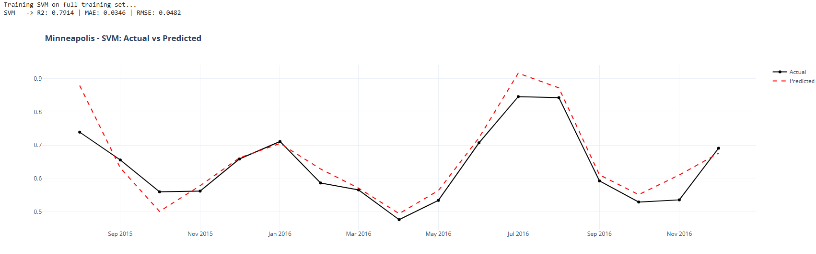
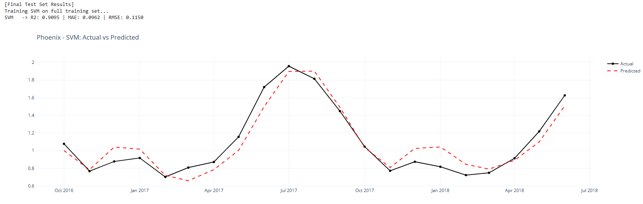
Results and Analysis (SVM)
11

Slide 12
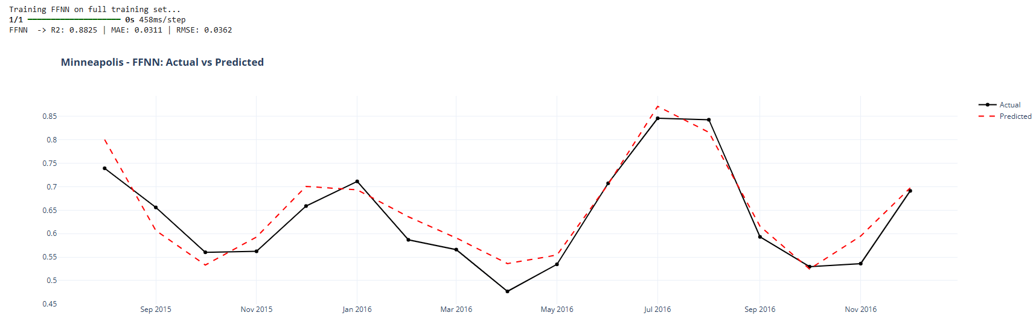
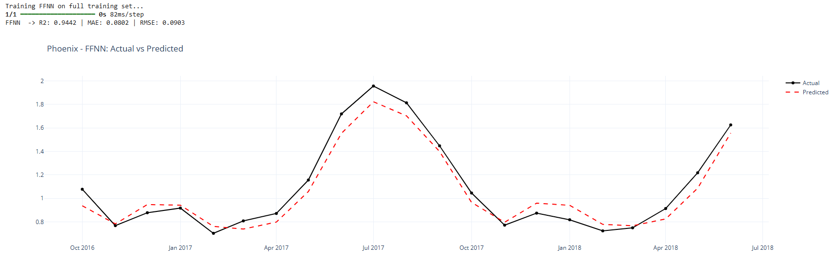
Results and Analysis (FFNN)
12

Slide 13
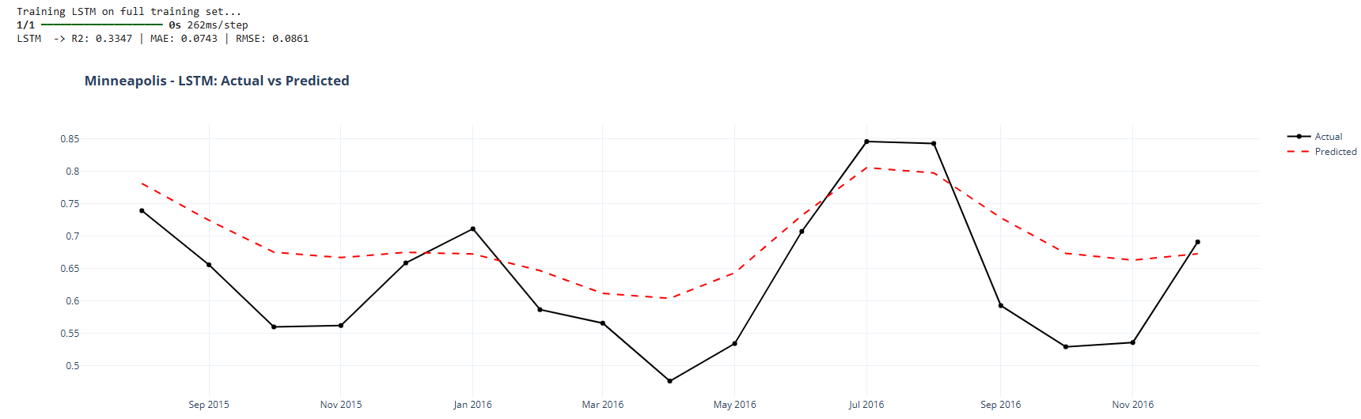
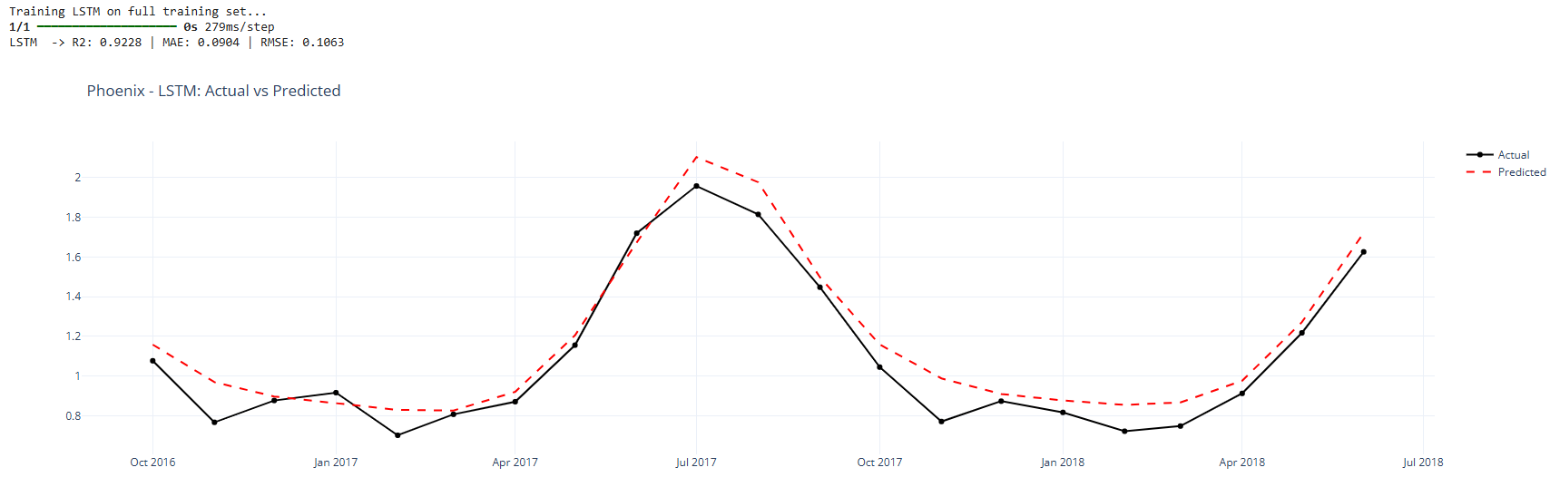
Results and Analysis (LSTM)
13

Slide 14
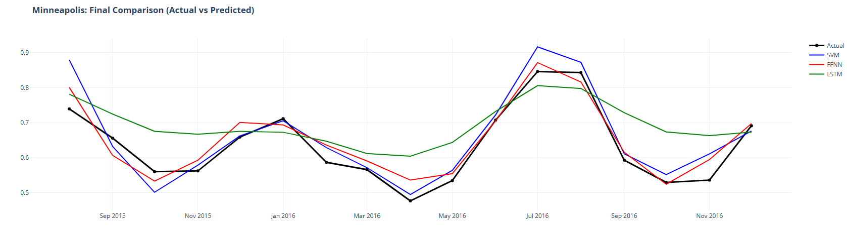
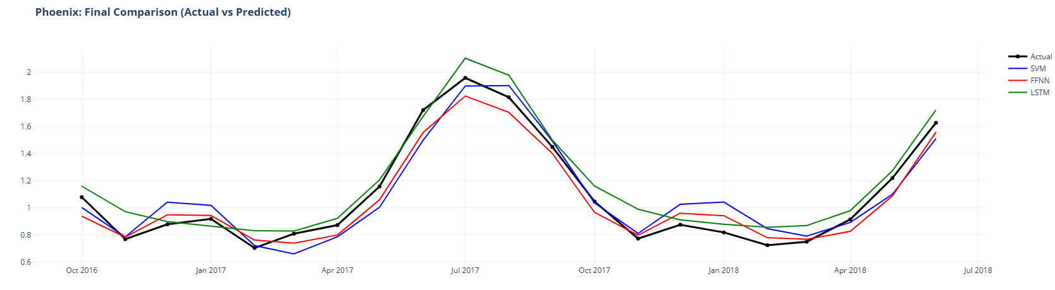
Results and Analysis (Final Comparison)
The predictions of all 3 models is quite close to the actual values
14

Slide 15
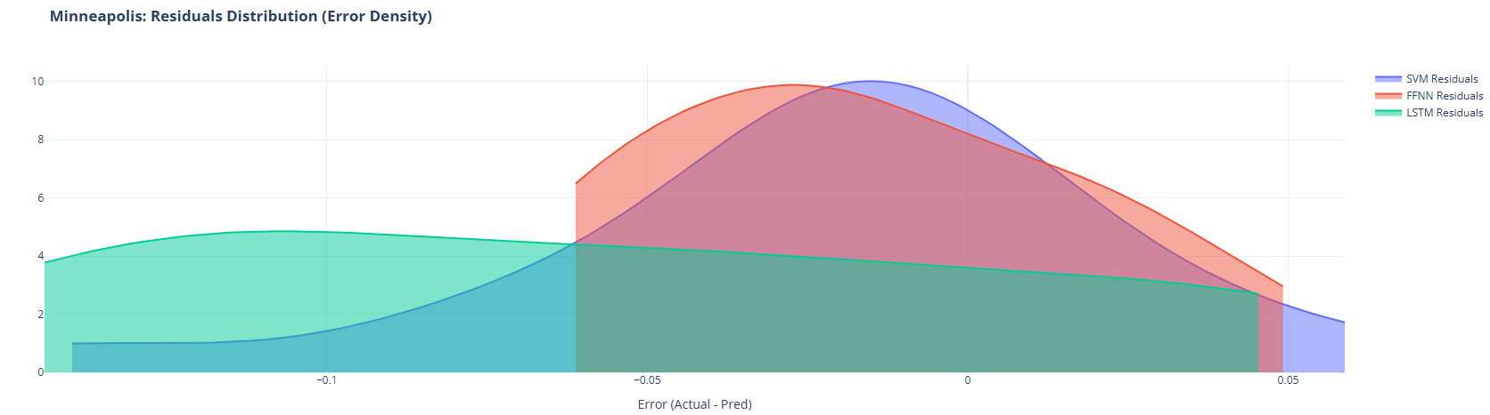
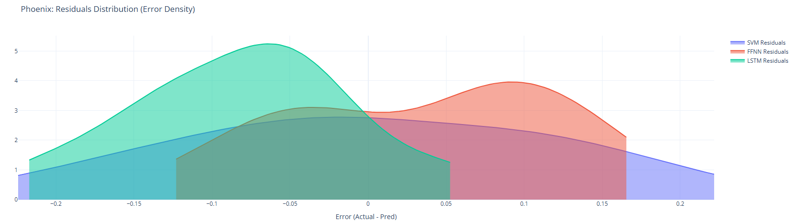
Results and Analysis (Residual Distribution)
Residuals for the predictions by the 3 ML models show a left skew for Minneapolis (long tail on the right) and a more normal like distribution for Phoenix
15

Slide 16
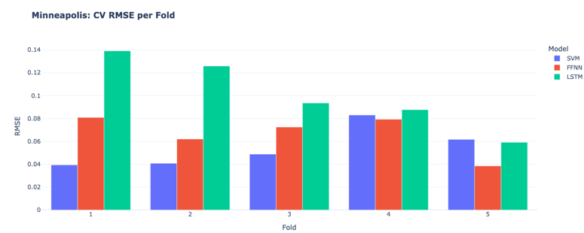
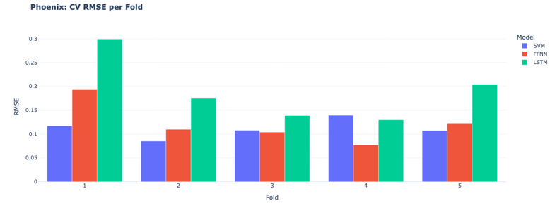
Results and Analysis (Cross Validation)
k-fold cross-validation shows consistent RMSE across folds, suggesting stable model performance and good generalization for both cities
16

Slide 17
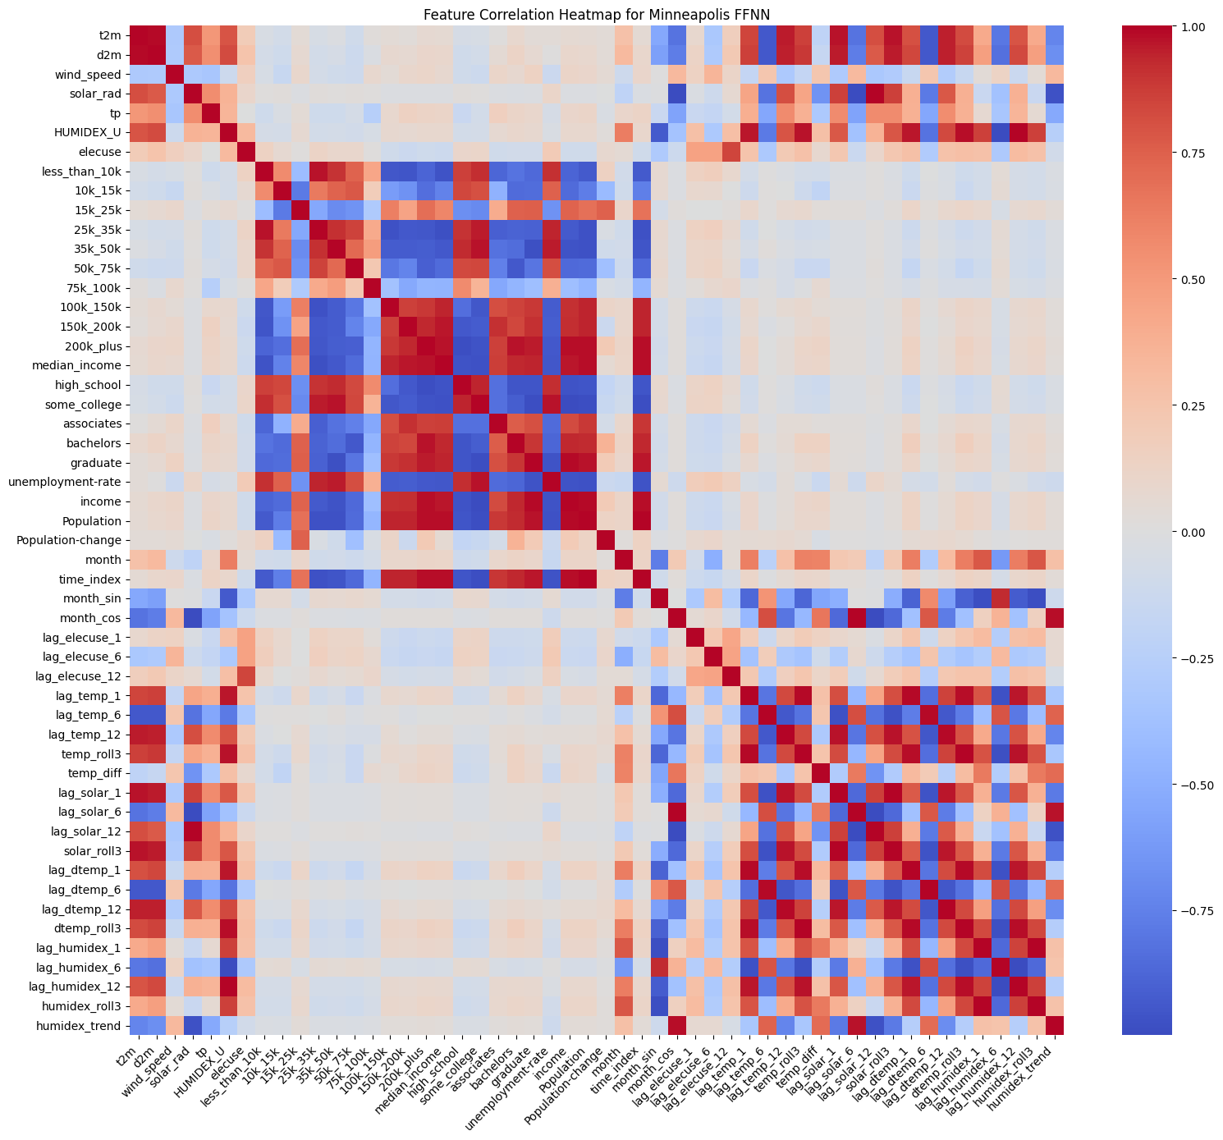
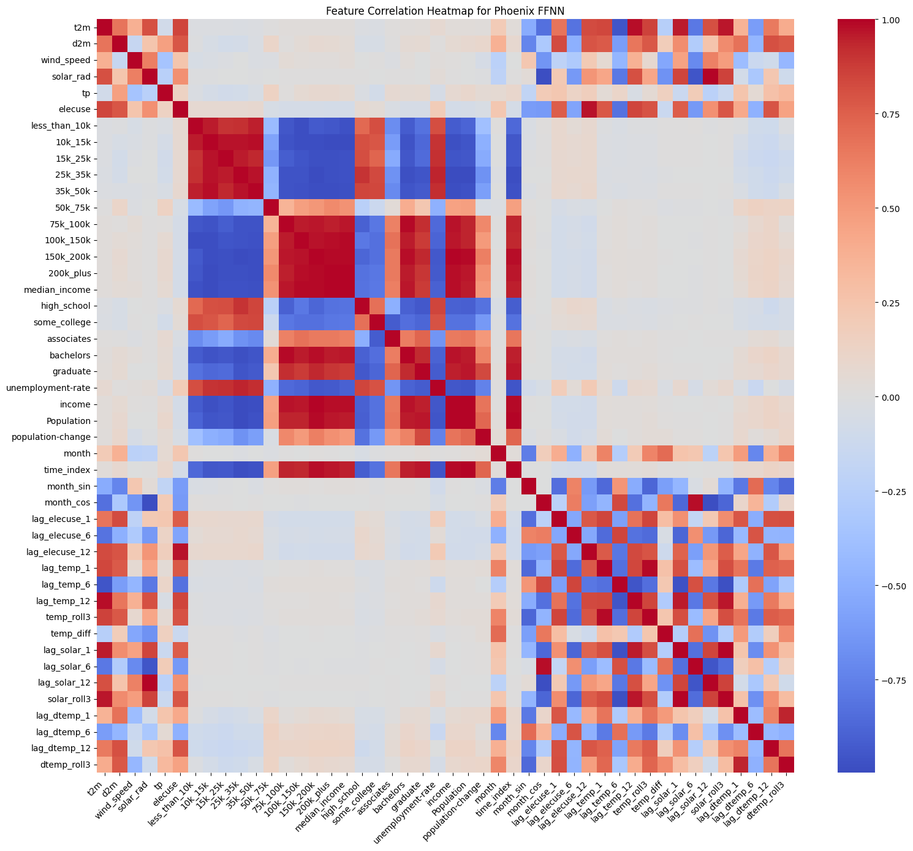
Results and Analysis (Correlation Heatmap)
Correlation heatmaps reveal strong temporal and climate-related relationships, supporting the inclusion of lagged variables and meteorological features
17

Slide 18
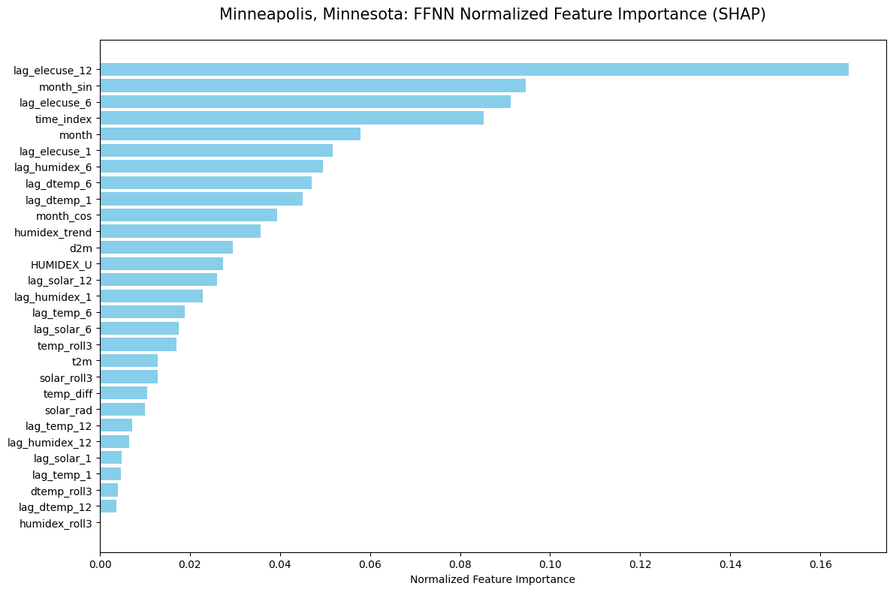
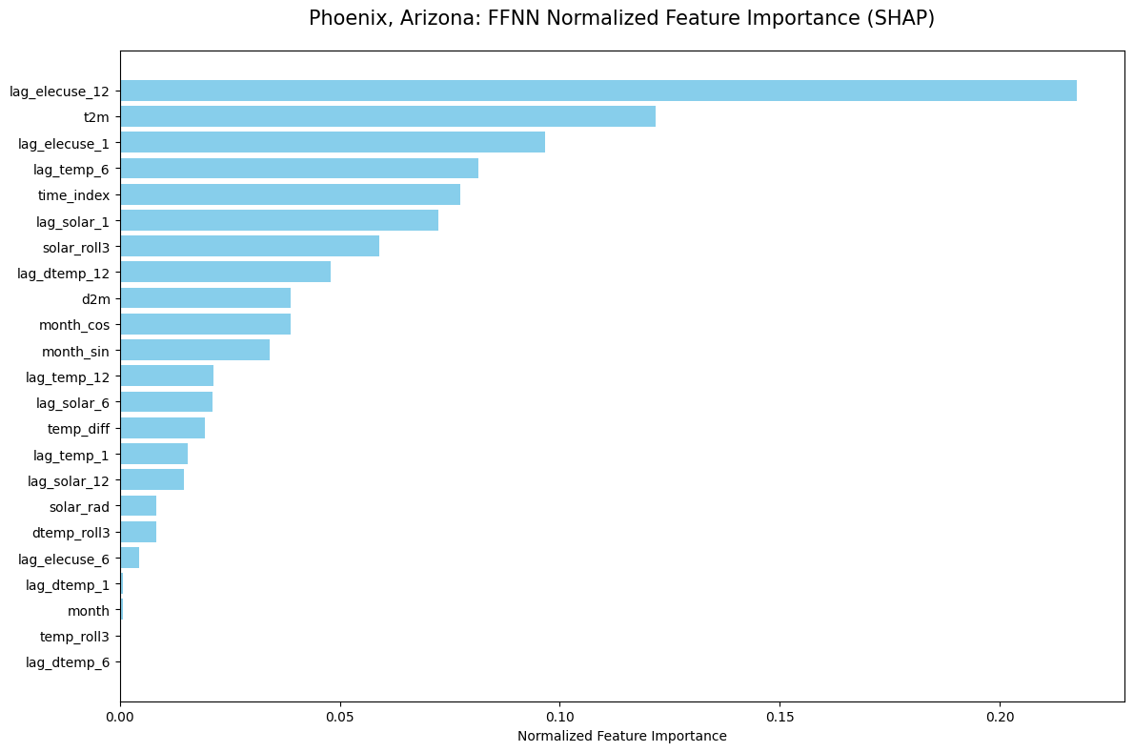
Results and Analysis (SHAP)
SHAP results indicate that lagged electricity consumption and temperature related features are the most influential predictors for both cities
18

Slide 19
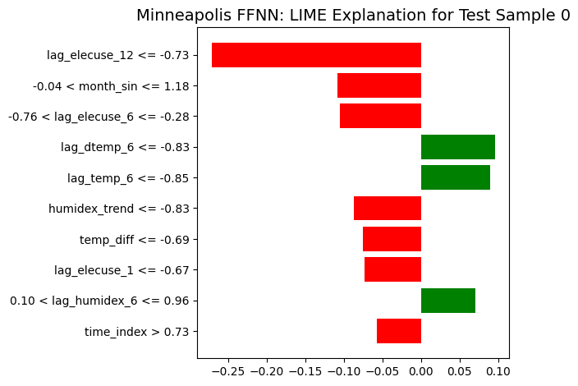
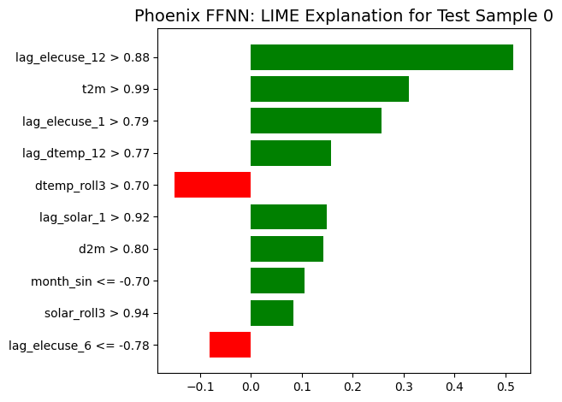
Results and Analysis (LIME)
LIME explanations demonstrate how individual predictions are driven by a small number of key features, providing local interpretability of the FFNN model
19

Slide 20
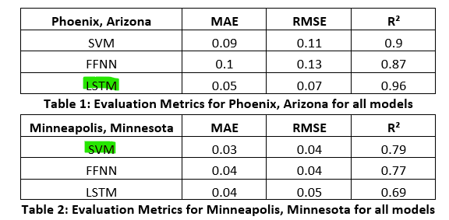
Results and Analysis (Hypothesis Testing)
Table 1 and Table 2 show the evaluation metrics for each model from the holdout data
Evaluation criteria: Minimum error (MAE & RMSE) and maximum correlation R²
LSTM performed best for Phoenix
SVM performed best for Minneapolis
Hypotheses made for each city:
H0: SVM or FFNN will be the best performing model
H1: LSTM performs better
19

Slide 21
Conclusion, Limitations, Future Work
Conclusion: LSTM is best for Phoenix, SVM is best for Minneapolis
For Phoenix, H0 is rejected and H1 is accepted
For Minneapolis, H0 is accepted
Good things:
Comfortable with building ML models in Python using real data
Applied ML concepts from literature (regression modeling, time-series learning, cross-validation) in our work
Saw the value of feature engineering and xAI techniques (SHAP, LIME)
Limitations:
Could not explore the impact of these 3 techniques on the radar dataset due as we had planned due to equipment issues.
Future Work:
Testing the models on other cities
Changing the time series period from monthly to weekly or daily if possible
Exploring hybrid architectures (e.g. CNN–LSTM models) from literature
20

Slide 22
References
Electricity Consumption Prediction
[1] R. Obringer, R. Nateghi, J. Knee, K. Madani, and R. Kumar, “Urban water and electricity demand data for understanding climate change impacts on the water-energy nexus,” Sci Data, vol. 11, no. 1, p. 108, Jan. 2024, doi: 10.1038/s41597-024-02930-z.
[2] Y. Radhika and M. Shashi, “Atmospheric Temperature Prediction using Support Vector Machines,” IJCTE, pp. 55–58, 2009, doi: 10.7763/IJCTE.2009.V1.9.
[3] G. Yin, T. Yoshikane, K. Yamamoto, T. Kubota, and K. Yoshimura, “A support vector machine-based method for improving real-time hourly precipitation forecast in Japan,” Journal of Hydrology, vol. 612, p. 128125, Sept. 2022, doi: 10.1016/j.jhydrol.2022.128125.
[4] N. Hasan, N. Nath, and R. I. Rasel, “A support vector regression model for forecasting rainfall,” in Proc. Int. Conf. Electrical, Information and Communication Technology (EICT), 2015, pp. 554–559, doi: 10.1109/EICT.2015.7392014.
[5] Y. Wang, X. Wang, X. Li, W. Liu, and Y. Yang, “Future Climate Prediction Based on Support Vector Machine Optimization in Tianjin, China,” Atmosphere, vol. 14, no. 8, p. 1235, Aug. 2023, doi: 10.3390/atmos14081235
[6] H. A. I. El-Azab, R. A. Swief, N. H. El-Amary, and H. K. Temraz, "Seasonal forecasting of the hourly electricity demand applying machine and deep learning algorithms impact analysis of different factors," *Scientific Reports*, vol. 15, no. 9252, Mar. 2025. [Online]. Available: https://www.nature.com/articles/s41598-025-91878-0
[7] M. Abumohsen, A. Y. Owda, and M. Owda, "Electrical load forecasting using LSTM, GRU, and RNN algorithms," *Energies*, vol. 16, no. 5, p. 2283, 2023. [Online]. Available: https://www.mdpi.com/1996-1073/16/5/2283
[8] G. Dudek, "A comprehensive study of random forest for short-term load forecasting," *Energies*, vol. 15, no. 20, p. 7547, Oct. 2022. [Online]. Available: https://www.mdpi.com/1996-1073/15/20/7547
[9] X. Cui, M. Lee, C. Koo, and T. Hong, "Energy consumption prediction and household feature analysis for different residential building types using machine learning and SHAP: Toward energy-efficient buildings," Energy and Buildings, vol. 309, p. 113997, Apr. 2024. [Online]. Available: https://www.sciencedirect.com/science/article/abs/pii/S0378778824001130
21

Slide 23

The End! ☺
22

